Slide 1
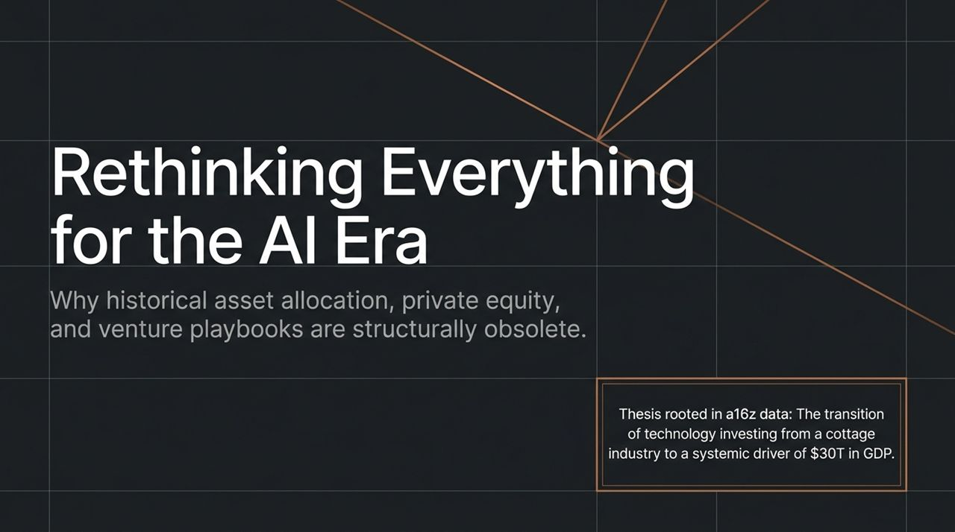
Notes:
Welcome, everyone. Today, we are discussing a fundamental shift in technology investing and asset allocation.
Over the past two decades, venture capital, private equity, and institutional portfolio construction followed a predictable playbook. However, as technology transitions from a niche, specialized asset class into a systemic driver impacting over $30 trillion in global GDP, those historical models are no longer just outdated—they are structurally obsolete.
Drawing on data and insights from Andreessen Horowitz (a16z), this presentation breaks down why traditional VC structures are failing, why the dynamics of scaling startups have fundamentally flipped, and how institutional allocators must adapt their strategy to survive and thrive in the AI era.
https://www.youtube.com/watch?v=bsdJd2VeLvg

Slide 2
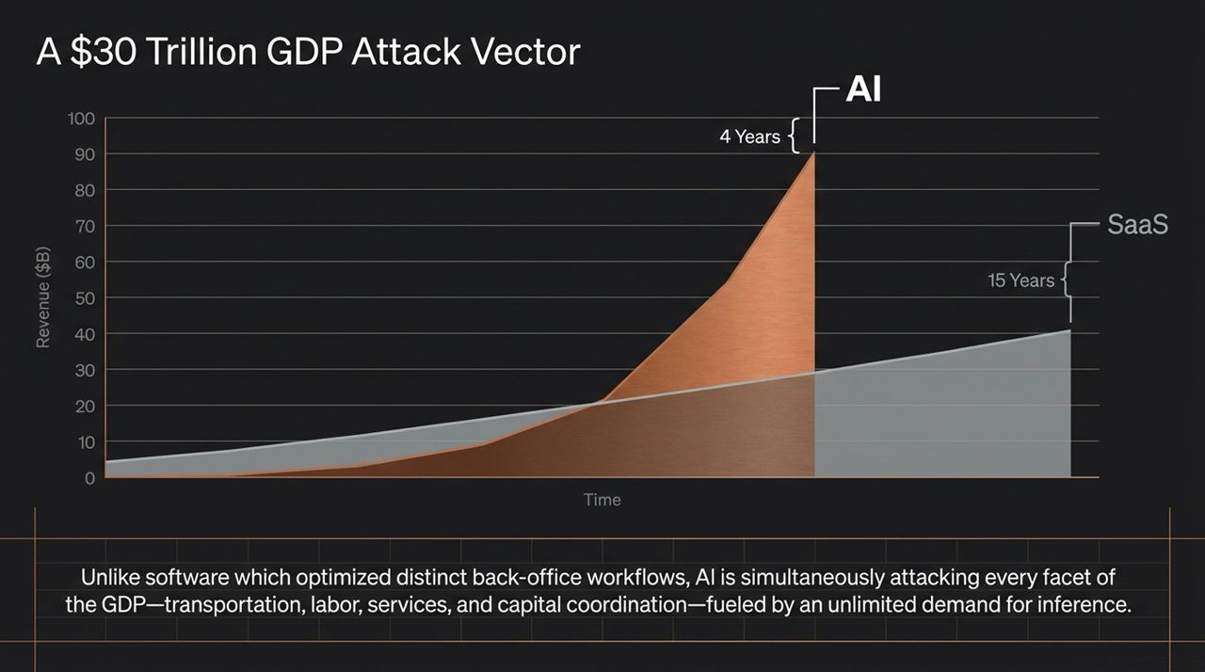
Notes:
Let’s look at the chart on this slide. During the SaaS boom, it took roughly 15 years for the software sector to scale toward $40B–$100B in market potential. AI, by comparison, reached $90B+ run-rates in roughly 4 years.
Why is this growth curve so drastically steep? Traditional SaaS optimized specific back-office workflows—think CRM, billing, or HR software—selling into enterprise IT budgets that capped out at tens of billions of dollars.
AI is fundamentally different. It does not merely sell software licenses; it directly attacks human labor and service costs across every sector of the GDP—transportation, legal services, healthcare, and financial coordination. Fueled by an almost unlimited demand for inference, AI expands the Total Addressable Market (TAM) from standard IT budgets to the multi-trillion-dollar global labor market.

Slide 3
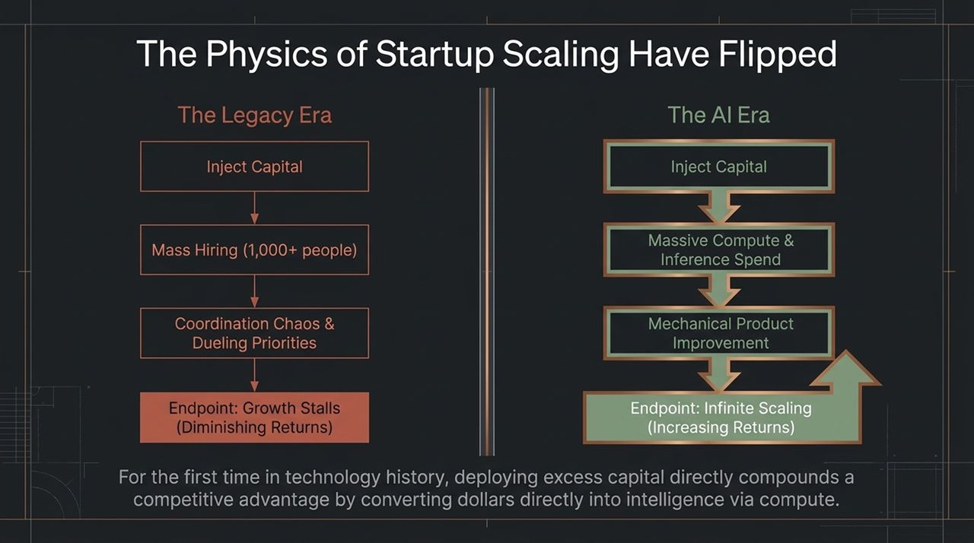
Notes:
Historically, scaling a technology startup suffered from severe operational friction. In the Legacy Era, when you injected $100 million into a company, the playbook mandated hiring 1,000+ employees. This inevitably created organizational chaos, competing priorities, and operational overhead, causing growth to stall due to diminishing returns on capital.
In the AI Era, the physics of startup growth have completely inverted.
When capital is injected today, it is converted directly into compute and inference rather than bloated headcount. Modern AI startups achieve massive revenue per employee because compute mechanically improves the product. For the first time in technology history, capital directly compounds into product intelligence and competitive advantage, enabling infinite scaling and increasing returns.

Slide 4
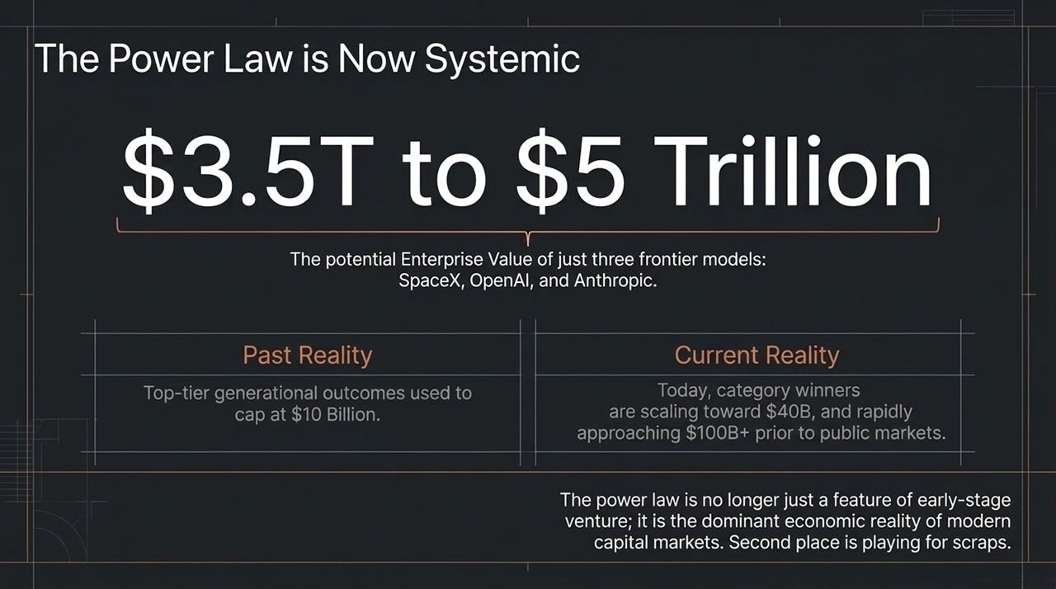
Notes:
The power law has always been a key characteristic of venture capital, but today it operates on an unprecedented scale.
In previous cycles, a generational outlier outcome was capped at around $10 billion. Today, category leaders like OpenAI, SpaceX, and Anthropic are reaching $40B to $100B+ valuations while remaining private. Together, the top three frontier AI models are projected to command between $3.5T and $5 trillion in enterprise value.
This creates a stark economic reality: the market is hyper-consolidating at the top. Second place is playing for scraps, and winning a share of these mega-winners is no longer optional for achieving fund-returning results—it is mandatory.

Slide 5
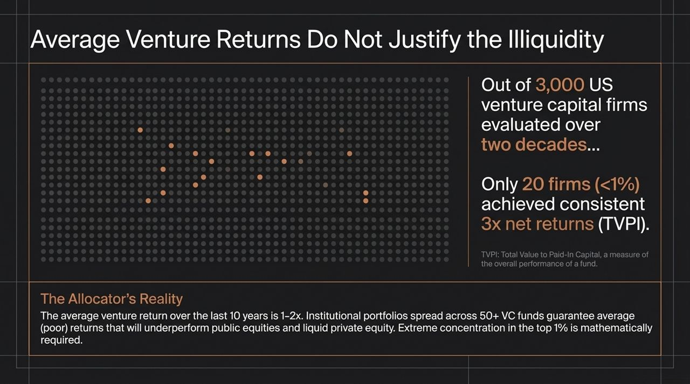
Notes:
Here is the uncomfortable truth for institutional allocators: average venture capital performance is broken.
An evaluation of over 3,000 US venture capital firms across two decades reveals that fewer than 20 firms—less than 1%—consistently achieved 3x net TVPI. The average venture fund over the last 10 years returned between 1x and 2x.
Given 10-to-12-year lockup periods, a 1.5x TVPI underperforms liquid public markets and private credit on a risk-adjusted basis. Allocators who spread capital across 50+ mid-tier VC funds are effectively guaranteeing sub-par returns. To outperform, institutional investors must hold heavily concentrated positions in the top 1% of managers.

Slide 6
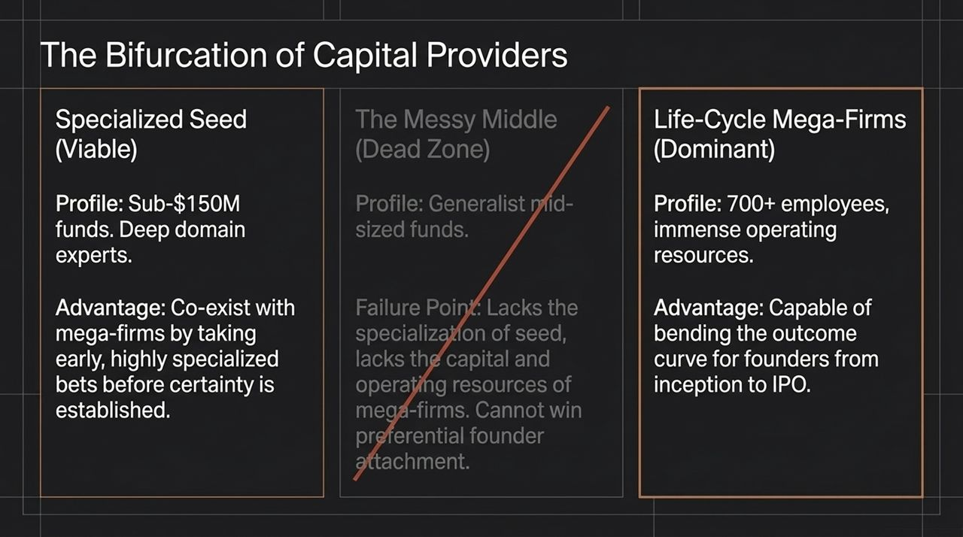
Notes:
Because average returns are under pressure, the market for venture capital firms is bifurcating, creating a 'Dead Zone' in the middle.
Specialized Seed Funds (<$150M): Highly viable. Domain-expert angels and seed funds win early access by making specialized bets before market consensus forms.
Life-Cycle Mega-Firms (Dominant): Armed with 700+ employees and vast operating infrastructure, mega-firms provide the capital required to support category leaders from inception to IPO.
The Messy Middle (Dead Zone): Mid-sized, generalist growth funds ($300M–$800M) are trapped in the middle. They lack the early conviction of seed funds and the capital firepower of mega-firms, making them unable to secure allocation in winning deals.

Slide 7
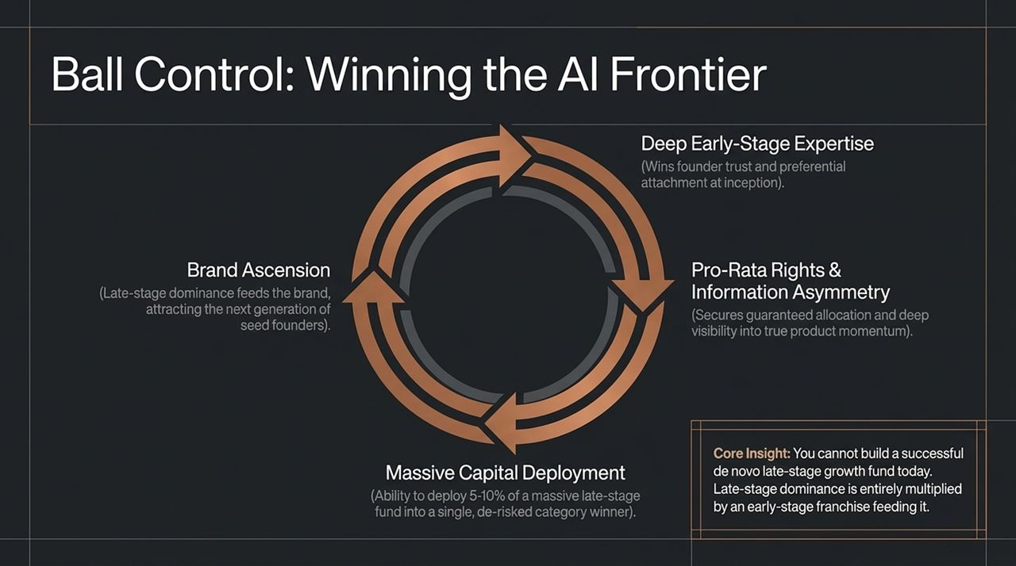
Notes:
To understand how top firms maintain dominance, we look at 'Ball Control'—a self-reinforcing flywheel:
Deep Early-Stage Expertise: Deep domain expertise earns founder trust at the seed stage.
Pro-Rata Rights & Information Asymmetry: Early entry secures pro-rata rights and unmatched insight into real product usage.
Massive Capital Deployment: When a clear winner emerges, the firm deploys massive growth capital (5–10% of a fund) into the de-risked winner.
Brand Ascension: Late-stage success feeds the firm's brand, attracting the next generation of top founders.
Core Insight: You cannot build a standalone late-stage growth fund today. Late-stage allocation is earned through early-stage deal flow.

Slide 8
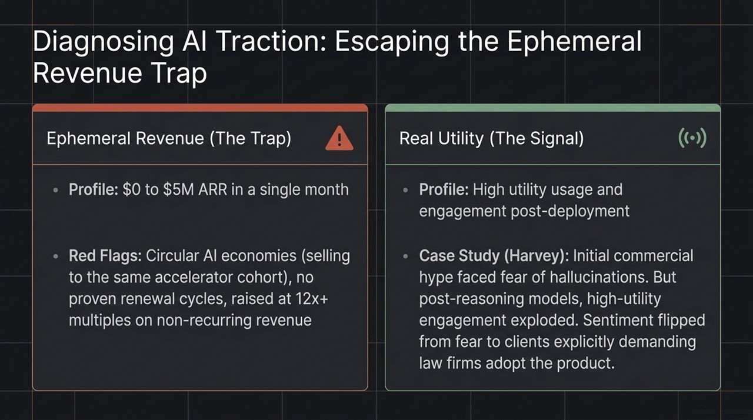
Notes:
Evaluating AI startups requires looking beyond top-line revenue growth. Many AI startups exhibit high initial growth that masks underlying churn.
Ephemeral Revenue (The Trap): A company growing from $0 to $5M ARR in weeks by selling to fellow YC/accelerator startups. These churn quickly once trial budgets run out.
Real Utility (The Signal): True durability is signaled by sustained engagement after initial deployment.
Take legal AI platform Harvey as an example: Initial adoption was muted due to fear of model hallucinations. Once reasoning capabilities improved, enterprise usage expanded, turning client demand into a pull market where corporate buyers insisted their legal counsel adopt the tool.

Slide 9
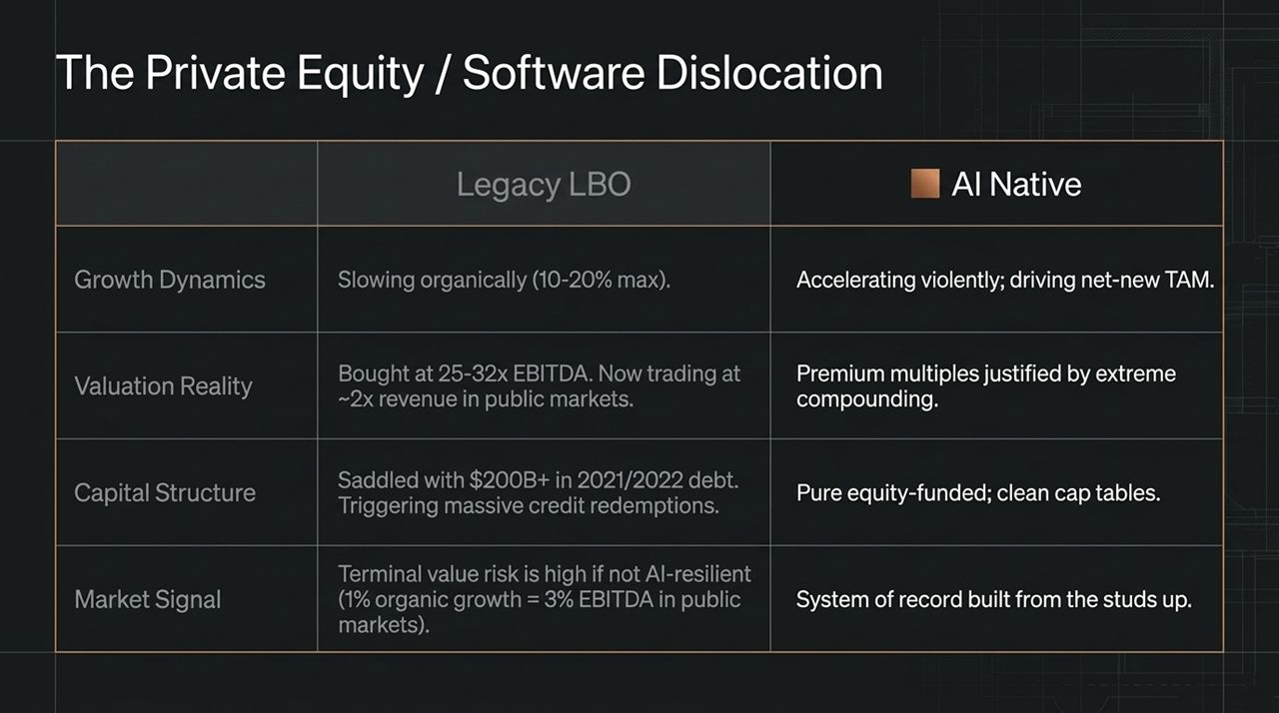
Notes:
The rise of AI presents significant structural risk to traditional Private Equity software buyouts.
Organic Growth: Legacy SaaS organic growth is slowing to 10–20%, while AI-native companies accelerate and create net-new TAM.
Capital Structure: Many 2021/2022 LBOs were acquired at 25x–32x EBITDA and loaded with over $200B in debt. As public software multiples adjust downward (~2x revenue), these debt loads create severe refinancing risks.
Terminal Value Risk: Traditional B2B software workflows risk disruption from AI-native systems built from the ground up.

Slide 10
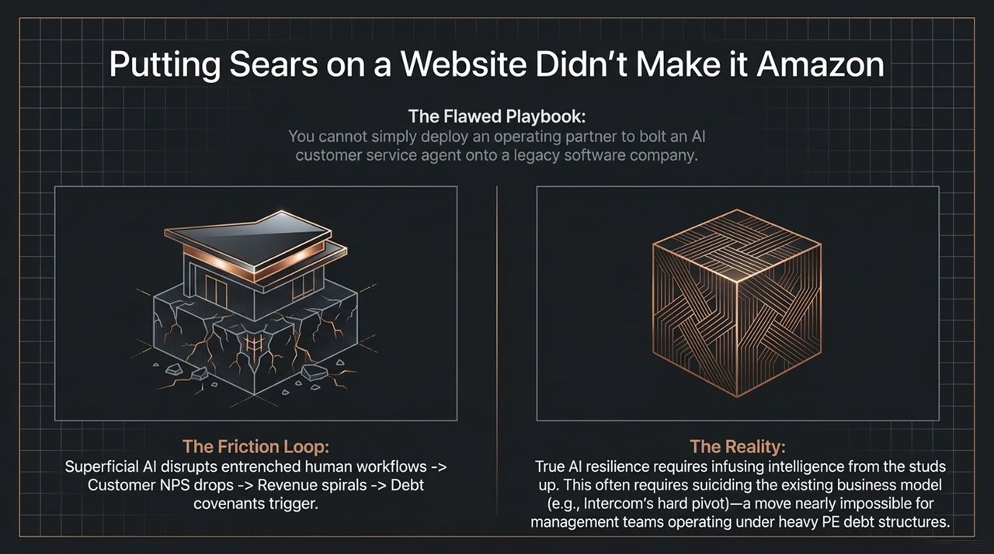
Notes:
Many PE firms attempt to protect portfolio companies by deploying operating partners to add AI features onto legacy software.
This superficial approach often fails. Bolting an AI chatbot onto legacy software creates user friction, harms customer satisfaction, and degrades net revenue retention.
Building an AI-resilient business requires re-engineering core architecture and business models from scratch. For example, customer support platform Intercom executed a complete product pivot to become AI-native—a high-risk transition that highly leveraged PE portfolio companies rarely have the financial flexibility to pursue.

Slide 11
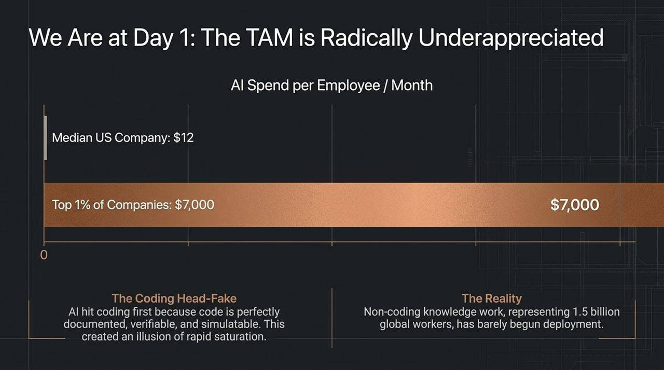
Notes:
Despite widespread AI coverage, market adoption remains in its early stages.
Spend Per Employee: The median US enterprise spends ~$12 per employee per month on AI tools, whereas power-user organizations spend up to $7,000 per employee monthly.
The Coding Head-Fake: AI made rapid initial progress in software engineering because code is structured, well-documented, and easily verifiable. This led some observers to assume AI integration was near saturation.
The Unclaimed Horizon: Broad knowledge work—comprising over 1.5 billion workers globally—is only beginning to adopt AI tools.

Slide 12
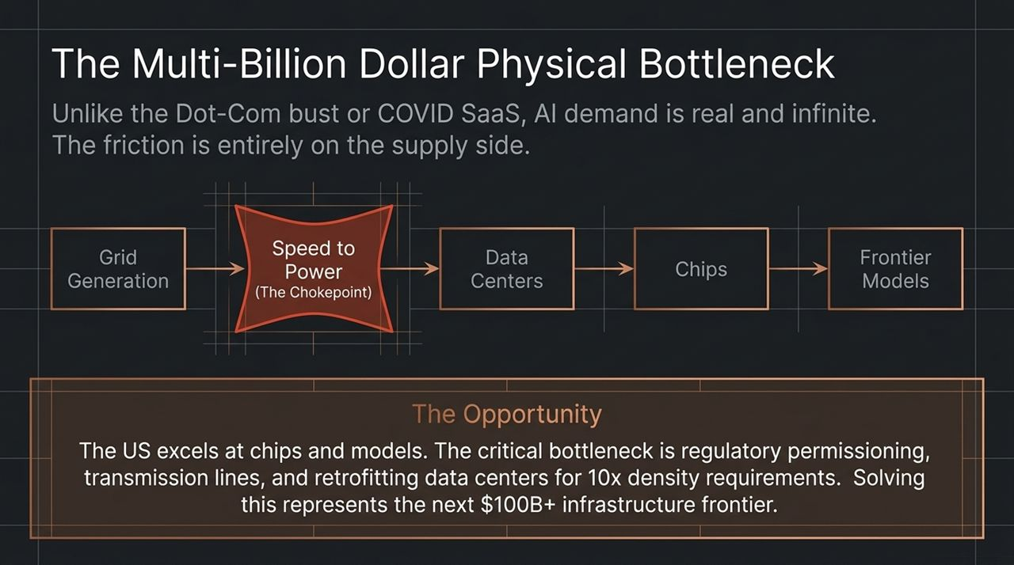
Notes:
Unlike past tech bubbles driven by speculative demand, AI demand is real and supply-constrained. The primary bottleneck for AI expansion is physical infrastructure.
The supply chain moves from Power Generation → Grid Interconnection → Data Centers → Chips → Frontier Models.
The main chokepoint is Speed to Power. Bringing new power generation and high-voltage transmission online requires navigating long regulatory approval timelines. Scaling modern data centers requires retrofitting facilities for up to 10x higher power density, representing a major infrastructure investment opportunity.

Slide 13
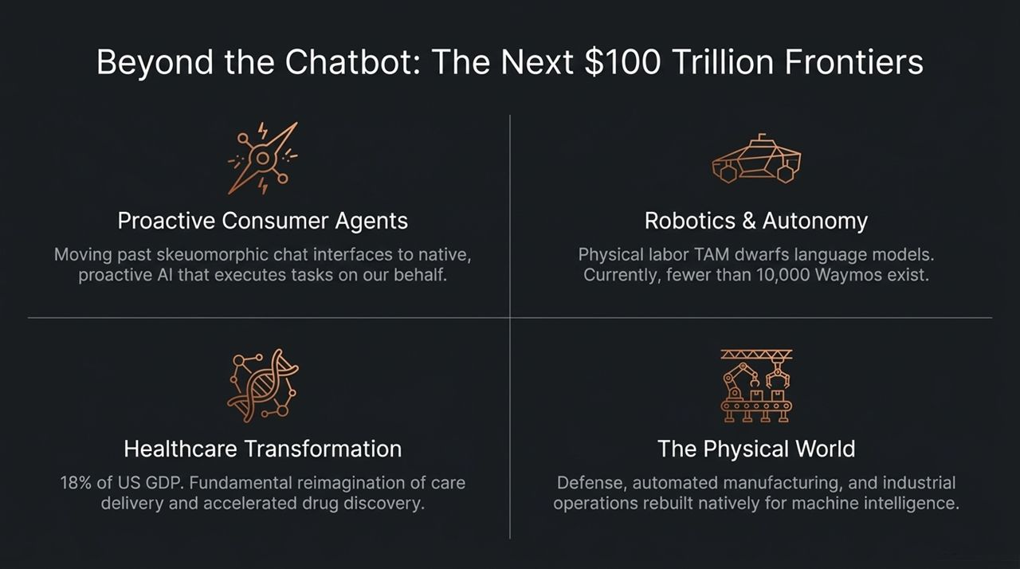
Notes:
While chat interfaces marked the first phase of consumer AI, future expansion lies in autonomous execution across several key frontiers:
Proactive Consumer Agents: Shifting from basic search queries to autonomous agents that handle complex workflows end-to-end.
Robotics & Physical Autonomy: Physical labor represents a vast market opportunity compared to software alone.
Healthcare Transformation: Healthcare represents 18% of US GDP. AI applications span automated administrative operations, clinical decision support, and accelerated drug discovery.
Industrial & Defense: Rebuilding manufacturing, supply chains, and defense logistics on autonomous architectures.

Slide 14
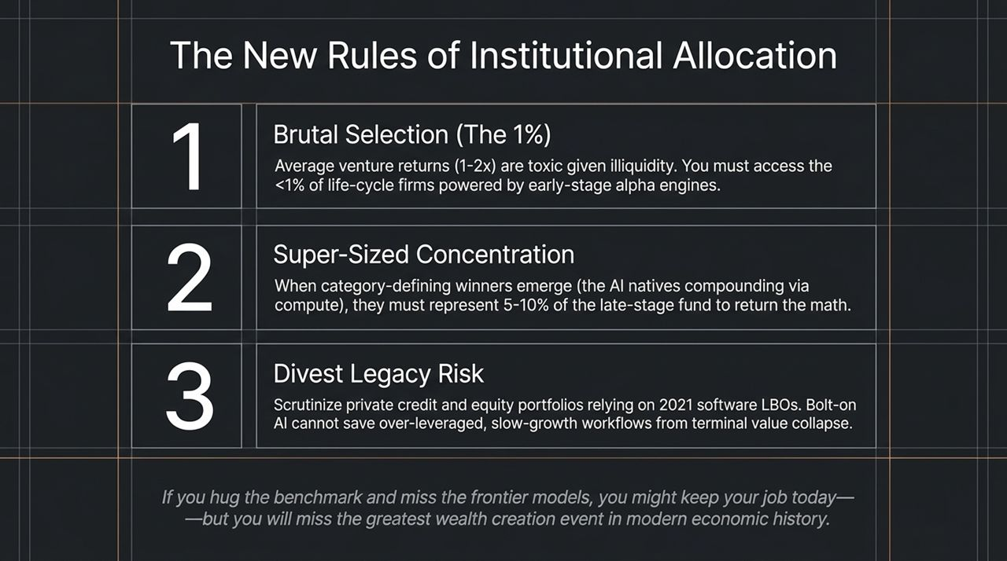
Notes:
To summarize, institutional allocators should consider three strategic adjustments in response to these market shifts:
Brutal Selection (Target the <1%): Avoid middle-tier generalist funds yielding 1x–2x TVPI. Focus allocation on top-tier life-cycle firms and specialized seed managers.
Super-Sized Concentration: Ensure growth-stage funds hold concentrated positions (5–10%+ of fund capital) in category-defining AI leaders.
Audit Legacy PE & Credit Exposure: Evaluate private credit and software buyout portfolios for exposure to legacy SaaS companies vulnerable to AI-native disruption.

Slide 15
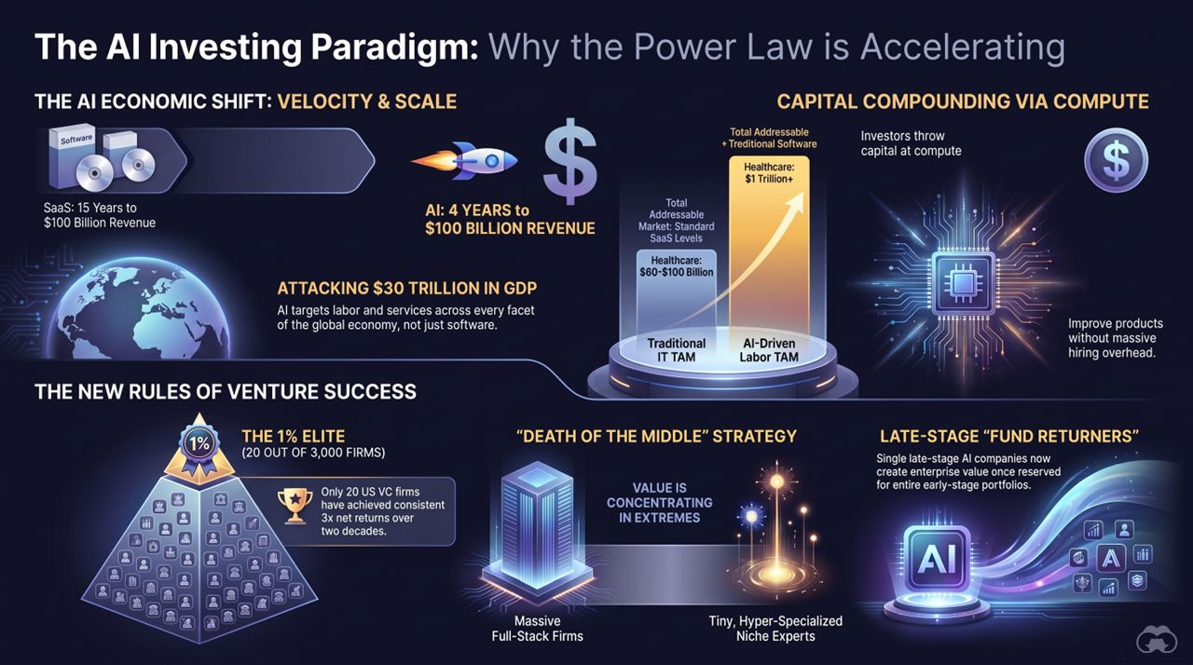
Notes:
Slide 15 synthesizes the core themes of this presentation:
Velocity & Scale: Transitioning from 15-year SaaS adoption cycles to 4-year AI expansion cycles.
Capital Compounding via Compute: Converting capital into compute to systematically improve product capabilities.
Attacking $30T in GDP: Expanding addressable markets from IT software budgets into global service and labor markets.
Bifurcated Market Dynamics: Value creation is concentrated at the extremes—large full-stack platforms and hyper-specialized niche providers.
https://www.youtube.com/watch?v=bsdJd2VeLvg

